Slide 1
Puritanism vs. The Enlightenment
Mid-1700s

Slide 2
The History of Ideas

Slide 3
Text p. 345
“John Adams would later reflect, ‘The Revolution was effected before the War commenced. The Revolution was in the minds and hearts of the people; a change in their religious sentiments, of their duties and obligations . . . this radical change in the principles, opinions, sentiments, and affections of the people, was the real American Revolution.’”
A revolution in morality and worldview– not just government.

Slide 4
Text p. 347
“Independence did not necessarily guarantee equitable and just governance. The declaration promised life, liberty, and the pursuit of happiness, but it would be up to the colonists whom we now call the Founding Fathers to secure those promises.”
In the end, life, liberty and PROPERTY are guaranteed unless taken after due process (5th and 14th Amendments to the Constitution)

Slide 5
The Great Awakening
Backlash movement away from Age of Reason in early-mid 1700s (think of “awakening” as IRONIC)
Series of Puritan religious revival meetings; long, scary sermons about sin and damnation
See Cliff Garboden article

Slide 6
Example of Calvinist (Puritan)
Belief Set:
Jonathan Edwards’ “Young Puritan’s Code”
  Exemplifies Calvinist/Puritan tenets:
    In the Intro ¶ , he says he’s unable to do anything without God’s help.
    You can speak “evil” of (criticize) someone who’s sinning, in order to do good by this criticism.

Slide 7
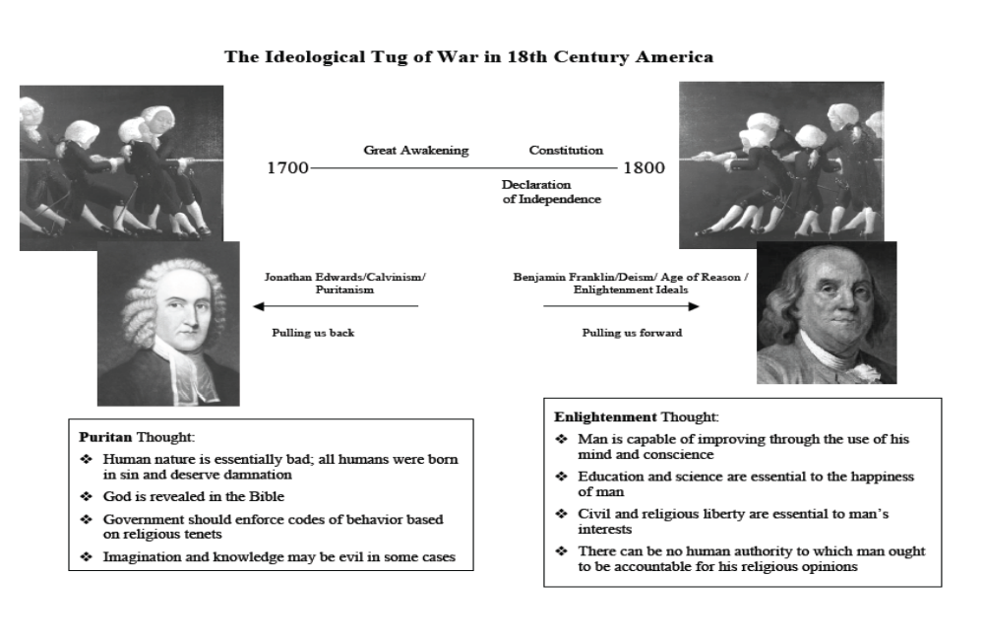

Slide 8
Which Side Won?
“Three Pieces of Paper”
The Declaration of Independence
The Constitution
The Bill of Rights

Slide 9
Key Ideals of The Enlightenment (also called the Age of Reason)

Slide 10
I. Emphasis on Reason, as exemplified in these ideas
A. All men should pursue happiness on earth, not just a select few in eternity
B. Evils of civilization are not from original sin but from faulty social environment
C. Put faith in reality of the world as revealed by the senses (i.e., nature)
D. Encourage education and scientific inquiry
E. Idea of man’s own perfectibility
1. man is master of his own fate
2. equality is based upon natural rights

Slide 11
II. Religion
A. Spread of Deism, a religion that was not an organized church with a hierarchy, but rather a set of personal beliefs leading to the following departures from traditional Christianity:
1. Christianity made less mystical and supernatural
2. Jesus not a divinity (but His teachings are valid)

Slide 12
Example of Deist/Enlightenment View:
Franklin’s List of 13 Virtues
  Defines chastity and temperance in a much more liberal way than a Calvinist would ever do:
    Emphasizes moderation rather than total self-denial
    Though Edwards didn’t mention sex, he would have put it within the confines of monogamous marriage; Franklin says go for it unless it’s harmful to yourself or others

Slide 13
Franklin’s List of 13 Virtues
Puts Jesus and Socrates on the same level!

Slide 14
The general attitude is summed up well in this quote from Franklin:
  “The most acceptable service to God is doing good to man.”
Remember: All this was going on, in part, during the Great Awakening—with people like Jonathan Edwards still preaching about sin and damnation! The ideas listed above were radical for their time. You might even say they were revolutionary !

Slide 15
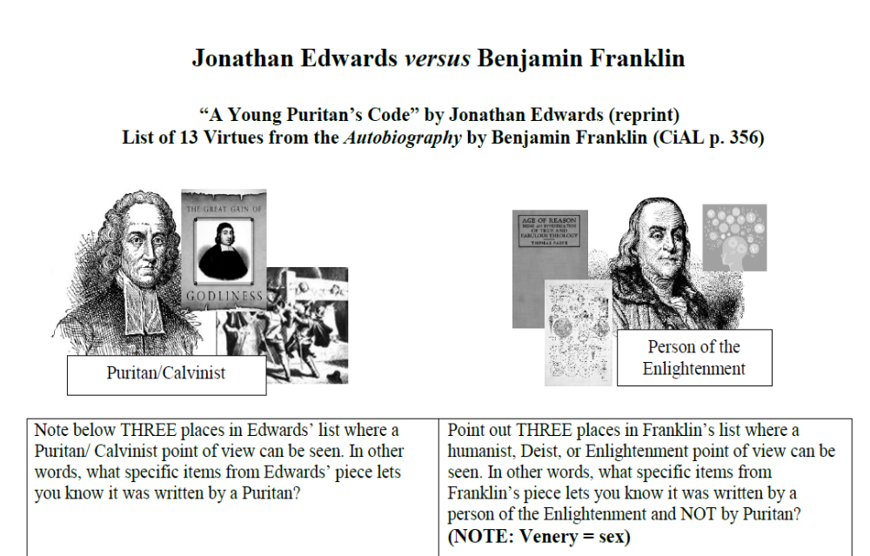

Slide 16
Text p. 348
Looking ahead:
As the nation grew, so too did the ideological rifts—Federalism versus states’ rights, freedom versus slavery, American ideals versus reality—that would threaten the very truths proclaimed in the Declaration of Independence…a new nation struggling with those rifts, one struggling to fulfill the promise of its birth.

